Slide 1
POST CATARACT CARE IN TAKEO EYE HOSPITAL
Residency Dr Leang Sam Ann/ Dr Neang Mao

Slide 3
Planning of postoperative care
The surgeon should evaluate the patient's ability to participate in postoperative care.
The surgeon, patient, caregivers should discuss the patient’s ability :
to administer eye drop
Maintain good ocular and general hygiene
Keep postoperative appointments

Slide 4
Planning of postoperative care
Patient also need to understand the importance of activity restriction:
Patient lifestyle
Type of surgery
Minimal activity limitation

Slide 5
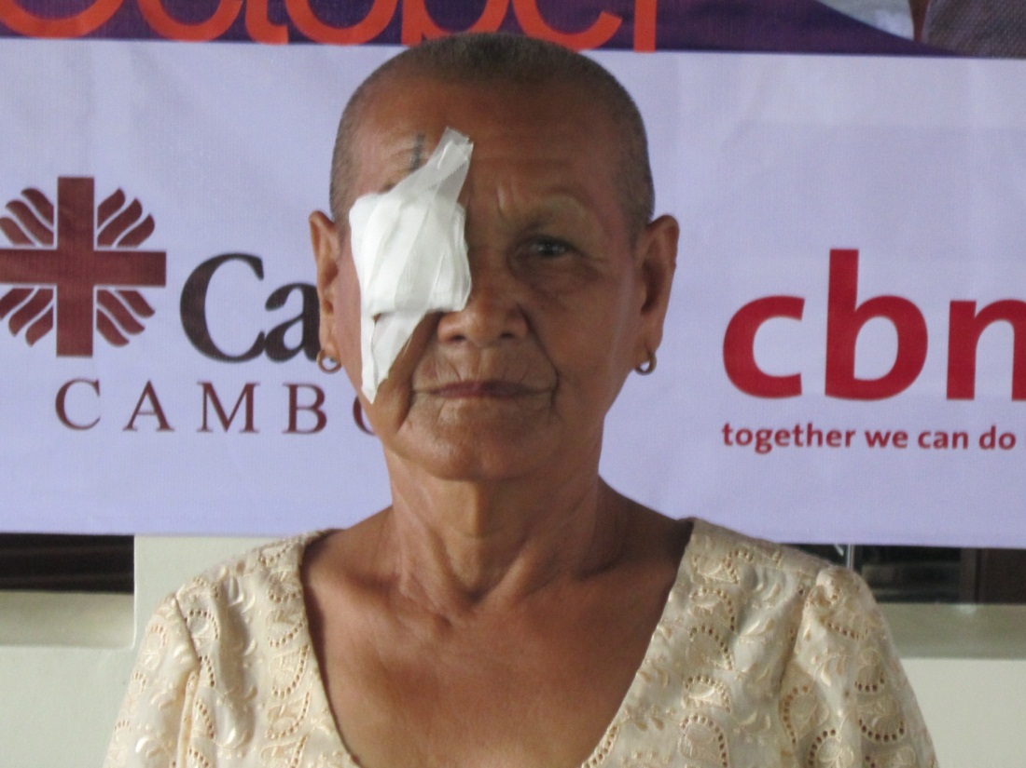
EYE PATCH
Patch the eye after completing cataract surgery.
Eye patch or eye shield
The patch until the first
postoperative appointment,
Usually to cleaning on
day after surgery in the next
morning.

Slide 6
Early post operative complication
Wound related
Wound leak
Iris prolapse
Induce astigmatism
Corneal
Corneal edema
Striate keratapathy
Anterior chamber
AC reaction
Hyphema
Vitreous in AC
IOP related
Raised
Low
IOL related
Decentered
Dislocated
Tilted
Pupillary capture
Capsular block syndrome
Acute endophthalmitis

Slide 7
EYE DROP
The drop is help to prevent infection and promote wound healing .
The doctor usually order two or three different kind of drops for use on specific schedule. (Dexa +Cipro x6)
Gradually taper dose of medication.

Slide 8
General instructions for postoperative patient after eye surgery
Physical activity: walking, talking, TV viewing can be resumed immediately after surgery.
Swimming, gardening, contact sport, jogging, etc avoid until 4-6 weeks.
Driving: avoid until surgeon give you permission.
Joining back duties: 4-6 weeks after surgery depending upon surgery.

Slide 9
Patient should not do
Rub the eye.
lift heavy weights.
Avoid contact infection visitors.
Play with children.
Strain at toilet. If needed please take laxative.
Alcoholic and cigarette smoking.
Handkerchief to mop the eye. Use sterile tissue only.

Slide 10
Instruction for installing medicine in the eye
Always install drop before ointment.
Leave a gap of 5 minute between two medication.
Keep the eye close 5 minute.
Replace the cape of bottle immediately after use.
Use 5 right method of medication.
Advice to have separate bottle for two eye.
Once open is discard and never used other person.

Slide 11
Date of follow up after surgery
Eye exam with slid lamp one day after surgery.
Further appointment usually:
2weeks
1 month after
If feel problem please see the doctor before follow up.

Slide 12
When should call the doctor
Do not hesitate to contact the doctor any of following:
Pain is not relieved by medication.
Deterioration of vision.
Excessive discharge from operative eye.
Sudden onset of flashes or floaters.

Slide 13
Late postoperative complication
Wound related
Astigmatism
Corneal
Bullous keratopathy
Corneal decompensating
Corneal melting.
Epithelium Down growth
IOP related
Glaucoma
Anterior Chamber
Chronic uveitis
UGH syndrome
Iris atrophy or cyst
IOL related
Malposition, glare
PCO, PHIMOSIS
Posterior segment
Retinal light toxicity
Macular infarction
CME/RD
Chronic Endophthalmitis

Slide 14
Age and gender of operated patients
Age |  | Male |  | Female | TOTAL
 | N | % | N | % | N | %
20-39 | 20 | 1.6 | 24 | 1.0 | 44 | 1.2
40-49 | 67 | 5.4 | 78 | 3.3 | 145 | 4.0
50-59 | 232 | 18.7 | 333 | 14.1 | 565 | 15.7
60-69 | 404 | 32.5 | 877 | 37.2 | 1,281 | 35.6
70-79 | 408 | 32.8 | 847 | 35.9 | 1,255 | 34.9
80+ | 112 | 9.0 | 199 | 8.4 | 311 | 8.6
Total | 1,243 | 100.0 | 2,358 | 100.0 | 3,601 | 100.0

Slide 15
Ag and gender of operative patients

Slide 16
Visual acuity in operated eye pre-op at discharge and follow up
 | Admission N= 3601 |  | 1-3weeks N=2865 |  | 4-11weeks N=1702 |  | 12+ weeks N=696 |  | WHO norms on outcome
Visual acuity | Pre-op% | Discharge% | Presenting % | Best% | Presenting % | Best% | Presenting % | Best% | Presenting % | Best%
6/6-6/18 | 4.1 | 50.0 | 53.5 | 68.2 | 57.5 | 72.0 | 63.9 | 76.9 | >80% | >90%
<6/18-6/60 | 34.2 | 42.7 | 39.1 | 26.7 | 35.7 | 23.8 | 31.5 | 20.0 | <15% | <5%
<6/60*** | 61.8 | 7.3 | 7.4 | 5.2 | 6.9 | 4.2 | 4.6 | 3.2 | <5% | <5%

Slide 17
Proportion of good/ Borderline/poor outcome by follow up (presenting VA)
 | Total ops N | Good N | % | Borderline N | % | Poor N | % | No data N | %
Discharge | 3,600 | 1,799 | 50.0 | 1,538 | 42.7 | 263 | 7.3 | 1 | 0.0
1-3weeks | 2,865 | 1,532 | 53.5 | 1,120 | 39.1 | 213 | 7.4 | 736 | 20.4
4-11weeks | 1,702 | 978 | 57.5 | 607 | 35.7 | 117 | 6.9 | 1,899 | 52.7
12+weeks | 696 | 445 | 63.9 | 219 | 31.5 | 32 | 4.6 | 2,905 | 80.7
WHO norms |  |  | >80% |  | <15% |  | <5%

Slide 18
Proportion of good/ Borderline/poor outcome by follow up (presenting VA)
 | Total ops N | Good N | % | Borderline N | % | Poor N | % | No data N | %
Discharge | 3,600 | 1,799 | 50.0 | 1,538 | 42.7 | 263 | 7.3 | 1 | 0.0
1-3weeks | 2,865 | 1,532 | 53.5 | 1,120 | 39.1 | 213 | 7.4 | 736 | 20.4
4-11weeks | 1,702 | 978 | 57.5 | 607 | 35.7 | 117 | 6.9 | 1,899 | 52.7
12+weeks | 696 | 445 | 63.9 | 219 | 31.5 | 32 | 4.6 | 2,905 | 80.7
WHO norms |  |  | >80% |  | <15% |  | <5%

Slide 20
Operative complication by place of surgery
 | Base hospital N=3601 |  | Other hospital N=0 |  | Out of hospital N=0
 | N | % of total ops | N | % of total ops | N | % of total ops
Capsule rupture without vitreous loss | 14 | 0.4 | 0 | 0.0 | 0 | 0.0
Vitreous loss | 59 | 1.6 | 0 | 0.0 | 0 | 0.0
Zonular dehiscence | 15 | 0.4 | 0 | 0.0 | 0 | 0.0
Retain lens matter | 2 | 0.1 | 0 | 0.0 | 0.0 | 0.0
Striated keratopathy | 2 | 0.1 | 0 | 0.0 | 0 | 0.0
Endophthalmitis | 39 | 1.1 | 0 | 0.0 | 0 | 0.0
other | 36 | 1.0 | 0 | 0.0 | 0 | 0.0
Wound leak | o | 0.0 | 0 | 0.0 | 0 | 0.0
Total | 167 | 4.6 | 0 | 0.0 | 0 | 0.0

Slide 22
Operative complication by cadre of surgeon
 | Consultant N=2346 |  | Trainee N=1255 |  | Non-doctor N=0
 | N | % of total ops | N | % of total ops | N | % of total ops
Capsule rupture without vitreous loss | 11 | 0.5 | 3 | 0.2 | 0 | 0.0
Vitreous loss | 19 | 0.8 | 40 | 3.2 | 0 | 0.0
Zonular dehiscence | 12 | 0.5 | 3 | 0.2 | 0 | 0.0
Retain lens matter | 1 | 0.0 | 1 | 0.1 | 0 | 0.0
Striated keratopathy | 0 | 0.0 | 2 | 0.2 | 0 | 0.0
Endophthalmitis | 24 | 1.0 | 15 | 1.2 | 0 | 0.0
other | 12 | 0.5 | 24 | 1.9 | 0 | 0.0
Wound leak | O | 0.0 | 0 | 0.0 | 0 | 0.0
Total | 79 | 3.4 | 88 | 7.0 | 0 | 0.0

Slide 24
Operative complication by additional ocular pathology
 | Corner scar N=103 |  | Old iritis N=11 |  | Retinal disease N=143 |  | Glaucoma N=38 |  | Others N=53
 | N | % of total ops | N | % of total ops | N | % of total ops | N | % of total ops | N | % of total ops
Capsule rupture without vitreous loss | 1 | 1.0 | 0 | 0.0 | 1 | 0.7 | 0 | 0.0 | 0 | 0.0
Vitreous loss | 1 | 1.0 | 0 | 0.0 | 1 | 0.7 | 0 | 0.0 | 1 | 1.9
Zonular dehiscence | 0 | 0.0 | 0 | 0.0 | 0 | 0.0 | 0 | 0.0 | 2 | 3.8
Retain lens matter | 0 | 0.0 | 0 | 0.0 | 0 | 0.0 | 0 | 0.0 | 0 | 0.0
Striated keratopathy | 0 | 0.0 | 0 | 0.0 | 0 | 0.0 | 0 | 0.0 | 0 | 0.0
Endophthalmitis | 1 | 1.0 | 0 | 0.0 | 0 | 0.0 | 0 | 0.0 | 0 | 0.0
other | 0 | 0.0 | 0 | 0.0 | 1 | 0.7 | 0 | 0.0 | 1 | 1.9
Wound leak | O | 0.0 | 0 | 0.0 | 0 | 0.0 | 0 | 0.0 | 0 | 0.0
Total | 3 | 2.9 | 0 | 0.0 | 3 | 2.9 | 0 | 0.0 | 4 | 3.9

Slide 26
Operative complications by type of surgery and IOL
 | Total operated case | Total complicated case | Total complicated case % | CR without VL | VL | Zonule dehiscence | Retained lens matter | Wound leak | Striated keratopathy | Endophthalmitis | Others
ICCE+AC IOL | 0 | 0 | 0.0 | 0 | 0 | 0 | 0 | 0 | 0 | 0 | 0
ICCE+No IOL | 0 | 0 | 0.0 | 0 | 0 | 0 | 0 | 0 | 0 | 0 | 0
ECCE+PC IOL | 37 | 5 | 13.5 | 0 | 2 | 0 | 0 | 0 | 0 | 0 | 3
ECCE+AC IOL | 0 | 0 | 0.0 | 0 | 0 | 0 | 0 | 0 | 0 | 0 | 0
ECCE+No IOL | 0 | 0 | 0.0 | 0 | 0 | 0 | 0 | 0 | 0 | 0 | 0
SICS+PC IOL | 3,350 | 127 | 3.8 | 11 | 40 | 6 | 2 | 0 | 2 | 35 | 31
SICS+ AC IOL | 12 | 11 | 91.7 | 0 | 2 | 9 | 0 | 0 | 0 | 0 | 0
SICS+No IOL | 24 | 11 | 45.8 | 0 | 10 | 0 | 0 | 0 | 0 | 0 | 1
Phaco+PC IOL | 177 | 13 | 7.3 | 3 | 5 | 0 | 0 | 0 | 0 | 4 | 1
Phaco+AC iol | 0 | 0 | 0.0 | 0 | 0 | 0 | 0 | 0 | 0 | 0 | 0
Phaco+No IOL | 1 | 0 | 0.0 | 0 | 0 | 0 | 0 | 0 | 0 | 0 | 0
Total | 3,601 | 167 | 4.6 | 14 | 59 | 15 | 2 | 0 | 2 | 39 | 36

Slide 28
Case of poor outcome at discharge and follow up
 | Total |  | Selection |  | Surgery |  | Spectacles |  | Sequelae
 | Number | % of all ops | Number | % poor outcome | Number | % poor outcome | Number | % poor outcome | Number | % poor outcome
Discharge | 263 | 7.3 | 138 | 52.5 | 125 | 47.5 | 0 | 0.0 | 2 | 0.0
1-3weeks | 213 | 5.9 | 112 | 52.6 | 97 | 45.5 | 2 | 0.9 | 2 | 0.9
4-11weeks | 117 | 3.2 | 69 | 59.0 | 47 | 40.2 | 0 | 0.0 | 1 | 0.9
12+weeks | 32 | 0.9 | 18 | 56.3 | 14 | 43.8 | 0 | 0.0 | 0 | 0.0

Slide 29
Reference
Annual report cataract outcome in Takeo Eye Hospital.
Leave let for education of postoperative care in TEH.
Section 11, basic and clinical science course (AAO).
Internet of Singapore National Eye Center(Care after cataract surgery.

Slide 30
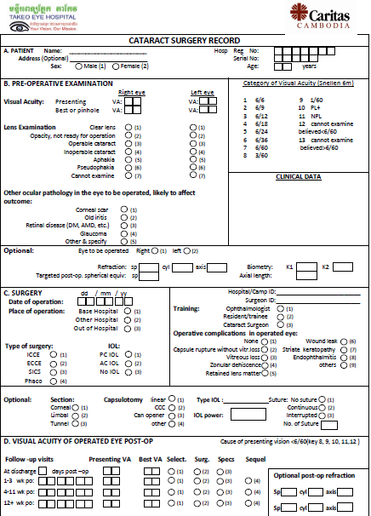

Slide 31
Thank you for attendance

